Slide 1

PART 2
Applications of Machine Learning
Transforming industries and reshaping daily life through intelligent systems.

Slide 2

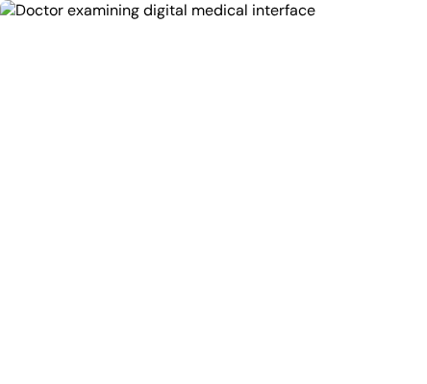
Healthcare
Disease Diagnosis: Analysis of medical images (X-rays, MRIs, CT scans) to identify anomalies with high precision.
Drug Discovery: Accelerating the development of new pharmaceutical compounds and predicting their efficacy.
Personalized Treatment: Tailoring medical plans based on individual genetic profiles and history.
Risk Prediction: Analyzing patient data to predict readmission risks and potential complications.
Early Detection: Identifying early warning signs of chronic diseases like cancer and diabetes.

Slide 3
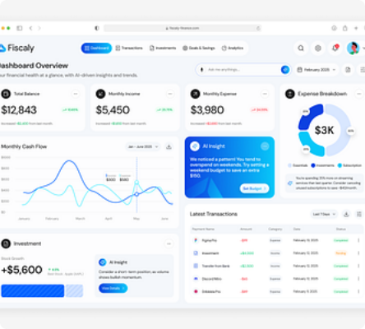
Finance
Fraud Detection: Real-time monitoring of credit card transactions to identify suspicious activities.
Algorithmic Trading: Automated stock market prediction and high-frequency trading execution.
Credit Scoring: AI-driven assessment of loan applicants to determine approval and interest rates.
Risk Management: comprehensive assessment of market risks and portfolio volatility.
Customer Churn: Predicting which clients are likely to leave and proactively engaging them.

Slide 4
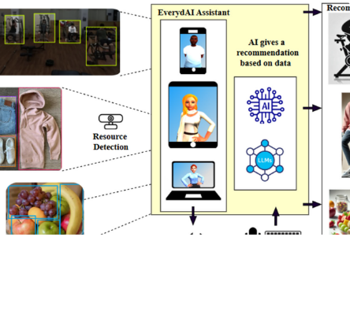
Technology & Internet
Recommendation Systems: Personalizing content on platforms like Netflix, YouTube, and Amazon.
Search Engines: Improving search relevance and ranking algorithms (e.g., Google, Bing).
Virtual Assistants: Natural language interaction via Siri, Alexa, and Google Assistant.
Spam Filtering: Automatically detecting and filtering unwanted emails and phishing attempts.
Content Curation: Algorithms that determine what content appears on social media feeds.

Slide 5
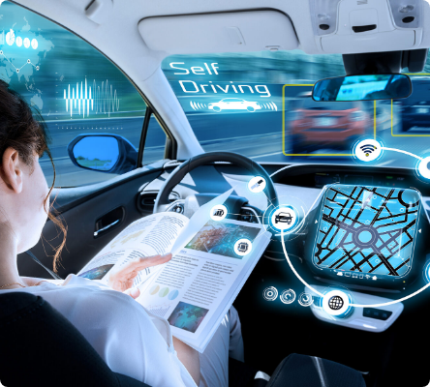
Transportation
Autonomous Vehicles: Self-driving cars utilizing computer vision and sensor fusion for navigation.
Traffic Prediction: Optimizing routes by analyzing real-time traffic flow data.
Predictive Maintenance: Monitoring vehicle health to predict failures before they occur in cars and aircraft.
Ride-Sharing: Optimizing driver allocation and pricing for services like Uber and Lyft.

Slide 6
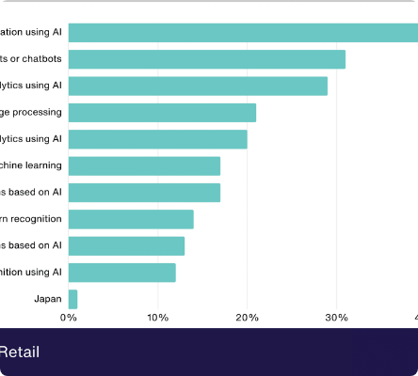
Retail & E-commerce
Demand Forecasting: Predicting future product demand to optimize inventory levels.
Dynamic Pricing: Adjusting prices in real-time based on demand, competition, and other factors.
Customer Segmentation: Grouping customers for targeted marketing campaigns.
Visual Search: Allowing users to search for products using images instead of text.
Product Recommendations: Suggesting items based on browsing history and purchase behavior.

Slide 7
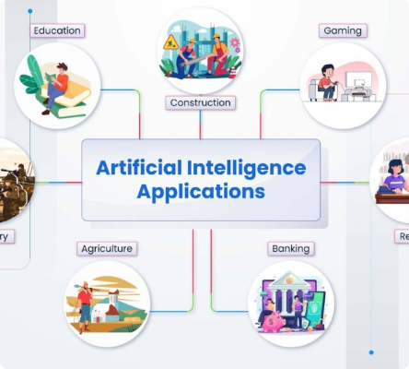
Other Key Applications
Language Translation: Real-time natural language translation services.
Recognition Systems: Advanced image and speech recognition capabilities.
Climate Modeling: Predicting weather patterns and modeling climate change scenarios.
Manufacturing: Automated quality control and defect detection on assembly lines.
Cybersecurity: Detecting potential threats and anomalies in network traffic.
Agriculture: Crop yield prediction and precision farming techniques.

Slide 8






Image Sources
https://cdn.prod.website-files.com/61af51425453b4a72f3a991a/65ddda4e50552a8f2d07a0c2_Podcast%20Episode%201%20(1).png
Source: www.optinum.co.za
https://cdn.dribbble.com/userupload/31600739/file/original-957c7e47c63a9fc21bbd9e35855042ff.png?resize=400x0
Source: dribbble.com
https://pub.mdpi-res.com/systems/systems-13-00753/article_deploy/html/images/systems-13-00753-g002.png?1762406171
Source: www.mdpi.com
https://blog.sintef.com/wp-content/uploads/2023/03/shutterstock-671755273-1.jpg
Source: blog.sintef.com
https://www.demandsage.com/wp-content/uploads/2025/03/AI-Use-Case-In-Retail.png
Source: www.demandsage.com
https://opencv.org/wp-content/uploads/2023/09/image-2-1024x576.jpeg
Source: opencv.org

